Slide 1
Analysis of single-cell RNA-seq data (V)
Hao Wu
Department of Biostatistics and Bioinformatics
Rollins School of Public Health
Emory University
Ziyi Li
Department of Biostatistics
The University of Texas MD Anderson Cancer Center
ENAR 2021 short course
March 2021

Slide 2
Course outline
8-9:15: Intro and data preprocessing.
9:15-9:45: Lab: preprocessing and visualization.
10-11:15: Normalization, batch effect, imputation, DE, simulator.
11:15-12: Lab: Normalization, batch effect, imputation, DE, simulator
12-1: Lunch break
1-2: Clustering and pseudotime construction
2-2:30: Lab: Clustering and pseudotime construction
2:45–3:30: Supervised cell typing & related single cell data sources
3:30-4: Lab: supervised cell typing.
4:15-5: scRNA-seq in cancer

Slide 3
Outline for this session
Background
Uniqueness of tumor tissue
Opportunities and challenges
Relevant computational methods
Unified analysis across condition and multiple samples
Distinguishing neoplastic from nonneoplastic cells
Inferring communication with tumor microenvironment
Delineating tumoral and microenvironment evolution
Other tumor-specific topics
Future opportunities

Slide 4
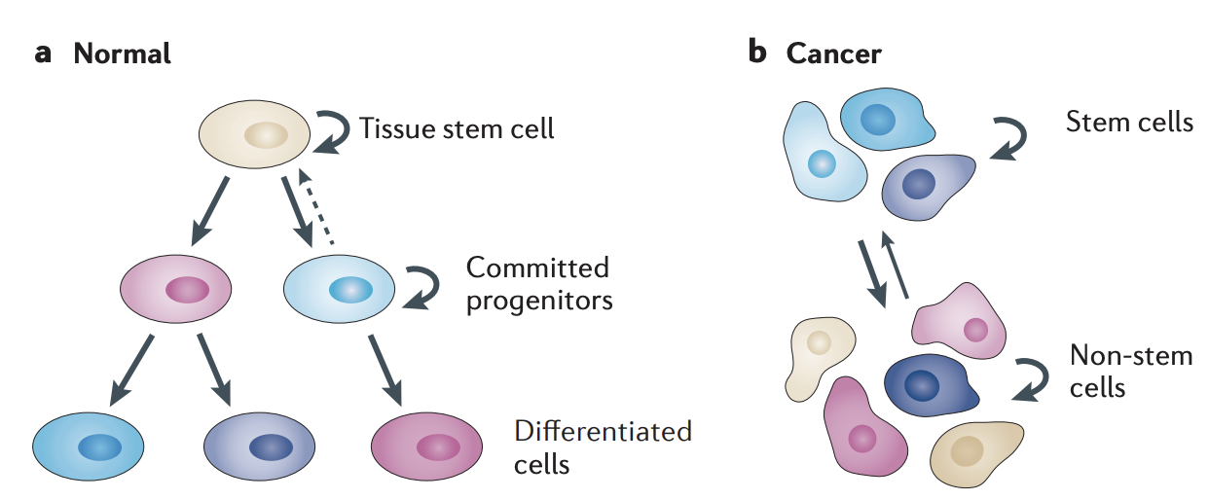
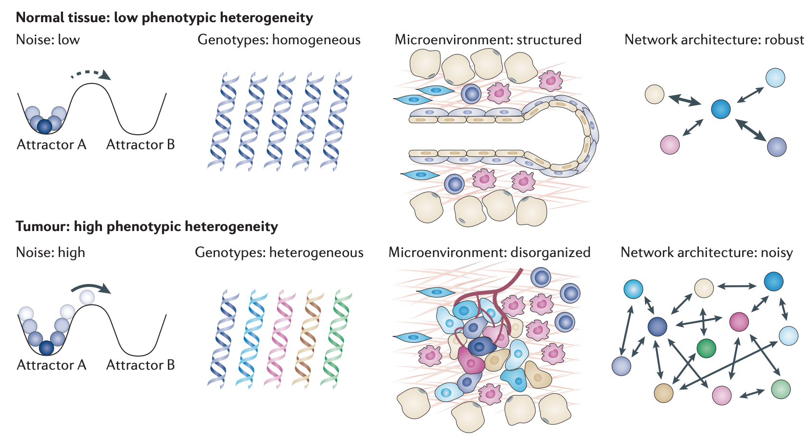
Uniqueness of tumor tissue
Differentiation hierarchies is changed in cancer cells
Different factors shape cellular phenotypes
Marusyk et al. 2012, Nat. Rev. Cancer

Slide 5
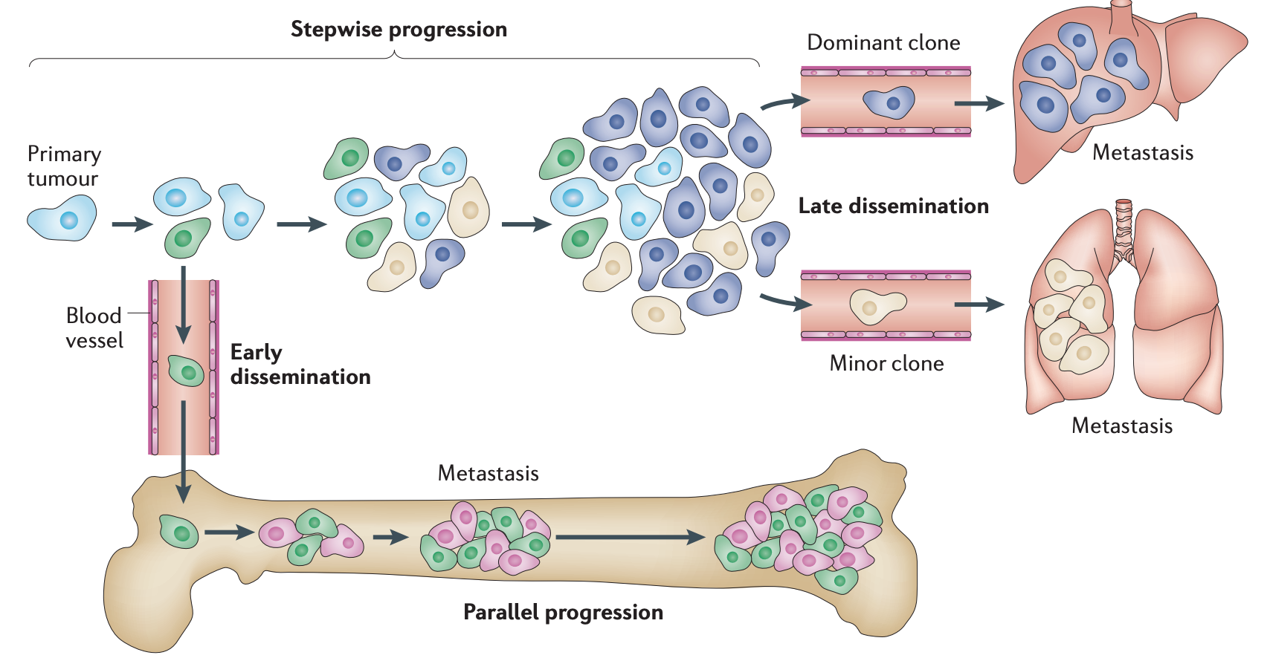
Uniqueness of tumor tissue
Marusyk et al. 2012, Nat. Rev. Cancer

Slide 6
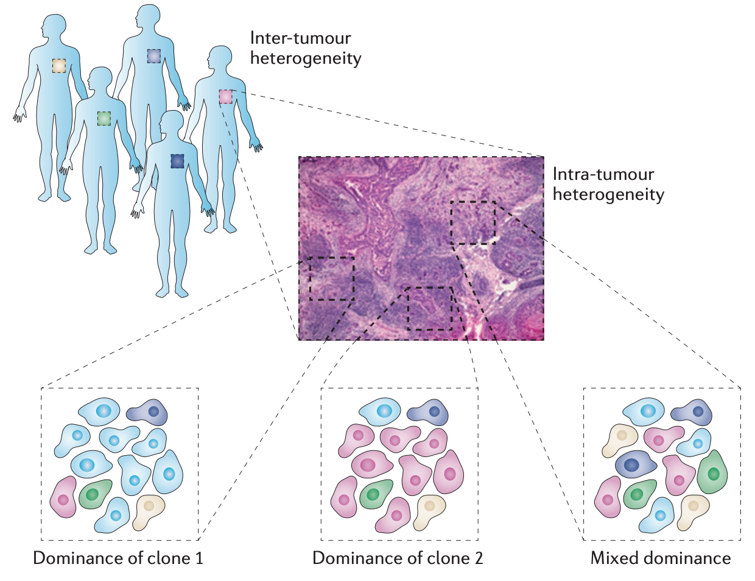
Uniqueness of tumor tissue
Marusyk et al. 2012, Nat. Rev. Cancer

Slide 7
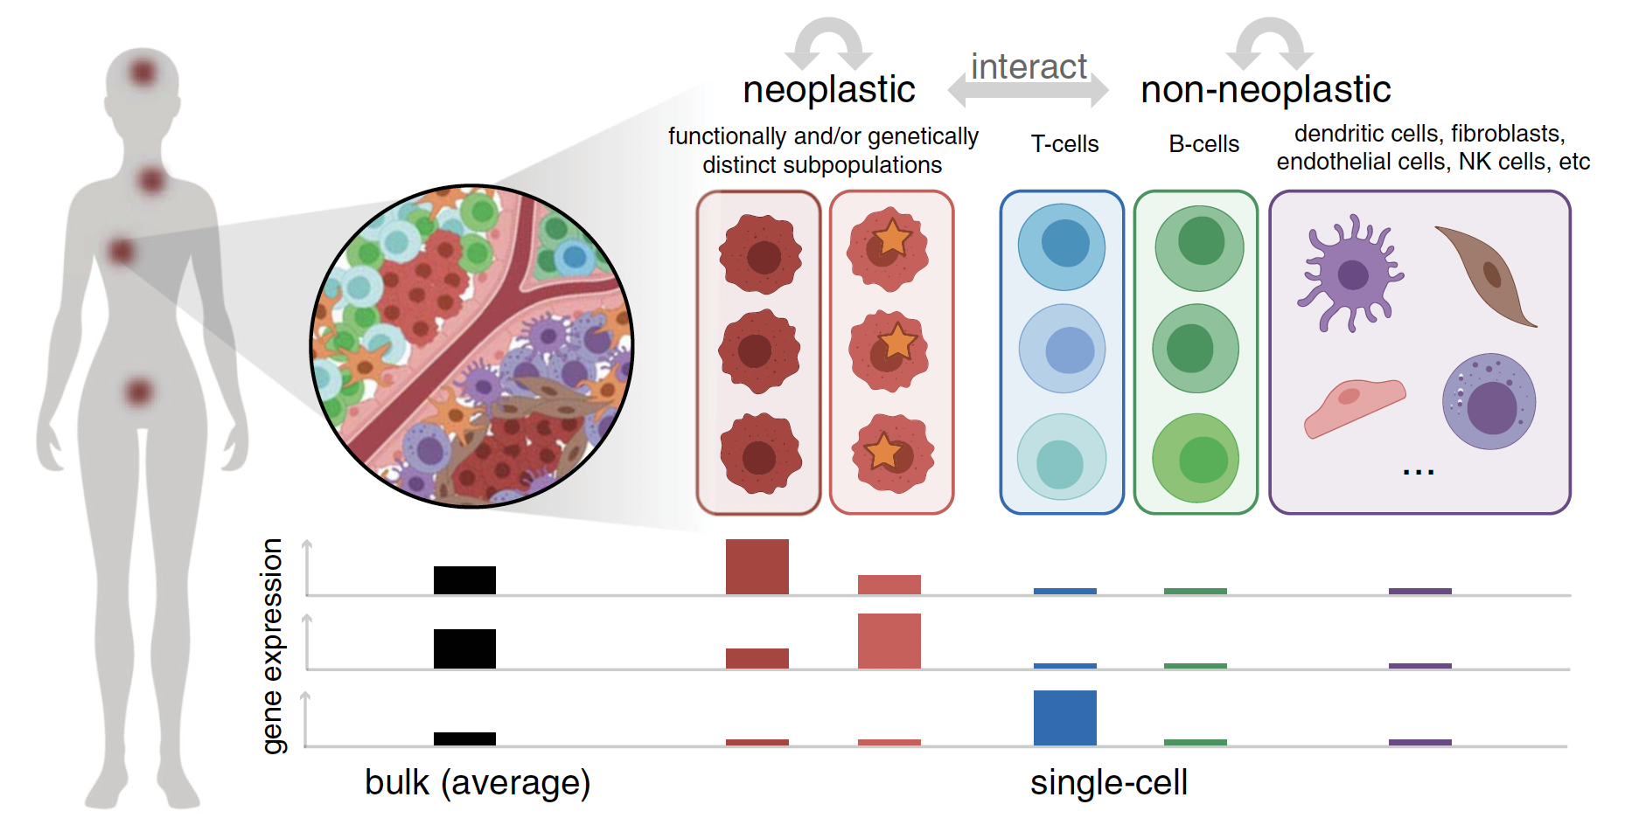
Single cell RNA-seq provides unbiased characterization of cell profiles in tumor environment
Fan et al. 2020. Experimental & Molecular Medicine

Slide 8
Unified analysis across many patients and disease states
Goal: identifying common cell types and states shared across patients and disease states from multiple scRNA-seq datasets.
Batch effect is a big concern here.
Batch correction tools: MultiCCA, MNN, combat, etc.
Newly emerged tools: LIGER, Harmony, scVI, SAUCIE

Slide 9
Challenges in clustering: neoplastic cells
Neoplastic cells aggregate by patient due to the inter-patient heterogeneity for neoplastic versus non-neoplastic cells
Neoplastic cells need to be considered separately from nonneoplastic cells
Clustering per patient is also recommended to avoid over-correction
Perform generic batch correction with caution

Slide 10
Distinguishing neoplastic from nonneoplastic cells
Neoplastic cells generally exhibit extensive alterations in a variety of biochemical pathways and oncogenic programs emblematic of cancer
Certain cancers - distinct marker genes or combinations of marker genes
E.g. multiple myeloma cells are marked by CD38+/CD138+ antigen expression

Slide 11
Distinguishing neoplastic from nonneoplastic cells (continue)
Other cancers - marker gene or pathway are not enough
Neoplastic cells can also express genes and pathways typically associated with canonical nonneoplastic cells in ways that we might not expect.
CNV inference-based detection: InferCNV, CopyKAT
Point mutation-based detection: HoneyBADGER
some cancers are not well defined by either large-scale CNVs or somatic point mutations (chronic myeloid leukemia – BCR-ABLfusion)

Slide 12
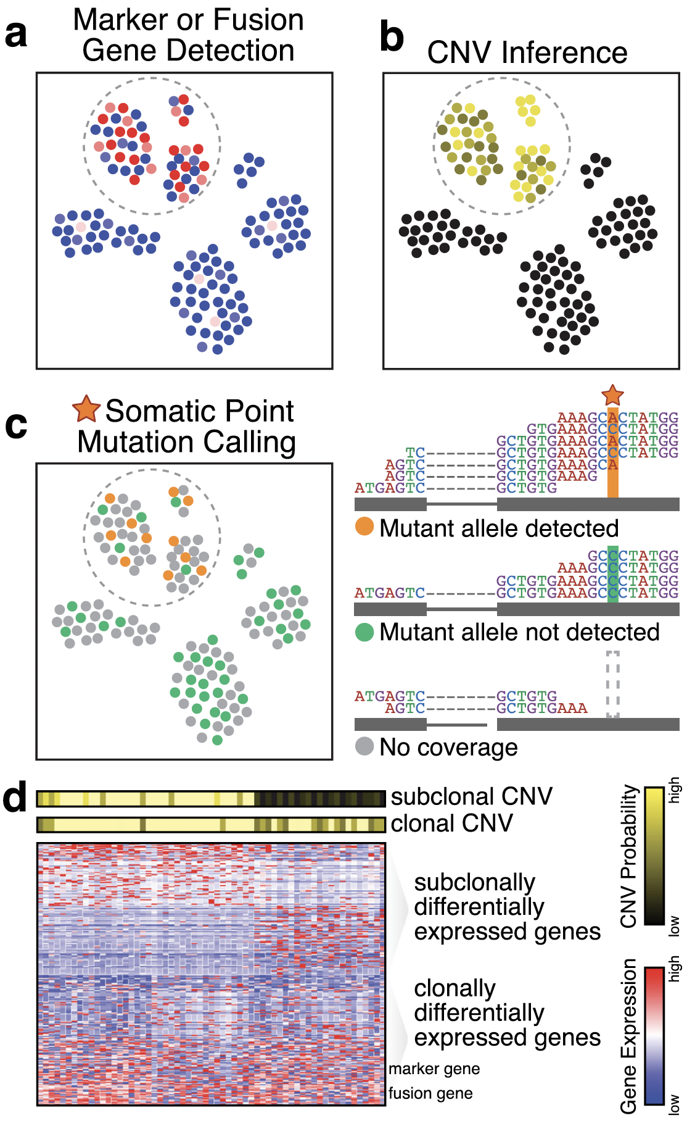
Fan et al. 2020.
Experimental & Molecular Medicine

Slide 13
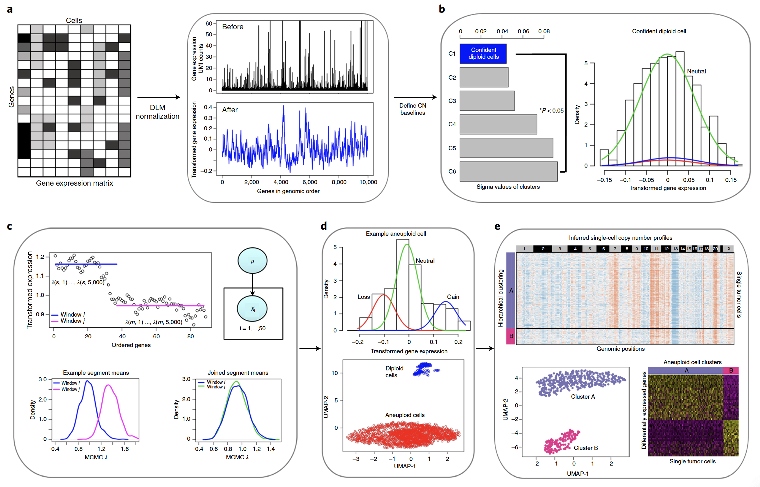
CopyKAT
Gao et al. 2021. Nature Biotech

Slide 14
Inferring communication within the tumor microenvironment
Infer putative communication of cell types: comparison of the expression levels of a receptor gene in one cell type and a corresponding ligand gene in another cell type
Methods: CellPhoneDB (2018 Nature, 2020 Nature protocol), CellTalker (2020 Immunity), NicheNet (2020 Nature Methods), iTalk (bioRxiv, 2019)

Slide 15
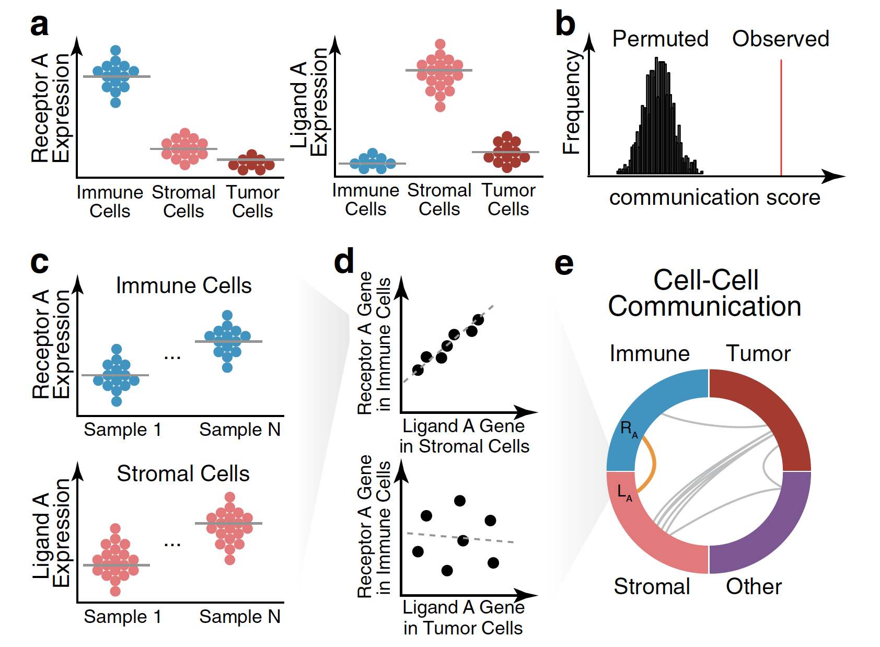
Fan et al. 2020.
Experimental & Molecular Medicine

Slide 16
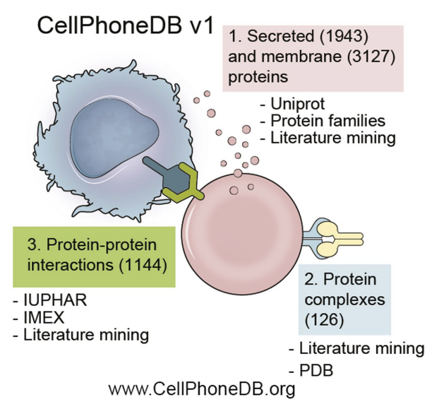
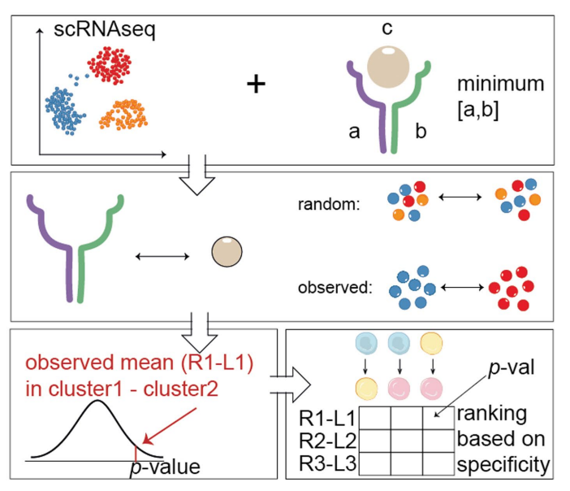
CellPhoneDB

Slide 17
Deconvolution of bulk RNA-seq using single cell RNA-seq data
Infer proportions of different immune and stromal cell type
Assumption: bulk sample is a mixture of multiple transcriptionally distinguishable cell types
Methods: MuSiC (Wang et al. 2019, Nat Comm), CibersortX (Newman et al. 2019, Nature)
Other: TIMER, Cibersort, MCP-counter, xCell
Marker gene selection is important - cancer cells may aberrantly express genes associated with canonical immune or nonneoplastic cell types

Slide 18
Delineating tumoral and microenvironmental evolution
Pseudotime construction methods could be used for trajectory construction
Special attention is needed for determining start and end point in trajectory construction
RNA velocity analysis

Slide 19
RNA velocity analysis
Has been applied on some cancer studies, but not cancer specific. It is originally designed for capturing developmental trajectory.
Balance between unspliced and spliced mRNAs is predictive of cellular state progression
Increase in the transcription rate: a rapid increase in unspliced mRNA -> increase in spliced mRNA -> new steady state
Drop in the rate of transcription: a rapid drop in unspliced mRNA -> reduction in spliced mRNA -> stead state
Such spliced/unspliced states can be identified using protocols of SMART-seq2, inDrop, STRT/C1, and 10x genomics
Notes:
WH: this is not necessarily for cancer. But could be used more broadly.

Slide 20
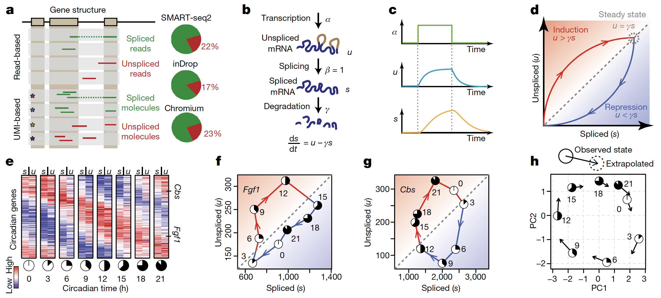
RNA velocity analysis

Slide 21
Futures
Single cell multi-omics: epigenetic heterogeneity and its interplay with transcriptional heterogeneity at the single-cell level
Spatial transcriptomics
International consortium: Human Cell Atlas, Human Developmental Cell Atlas, Pediatric Cell Atlas, HuBMAP, Human Tumor Atlas Network, LifeTime EU Flagship

